Slide 1
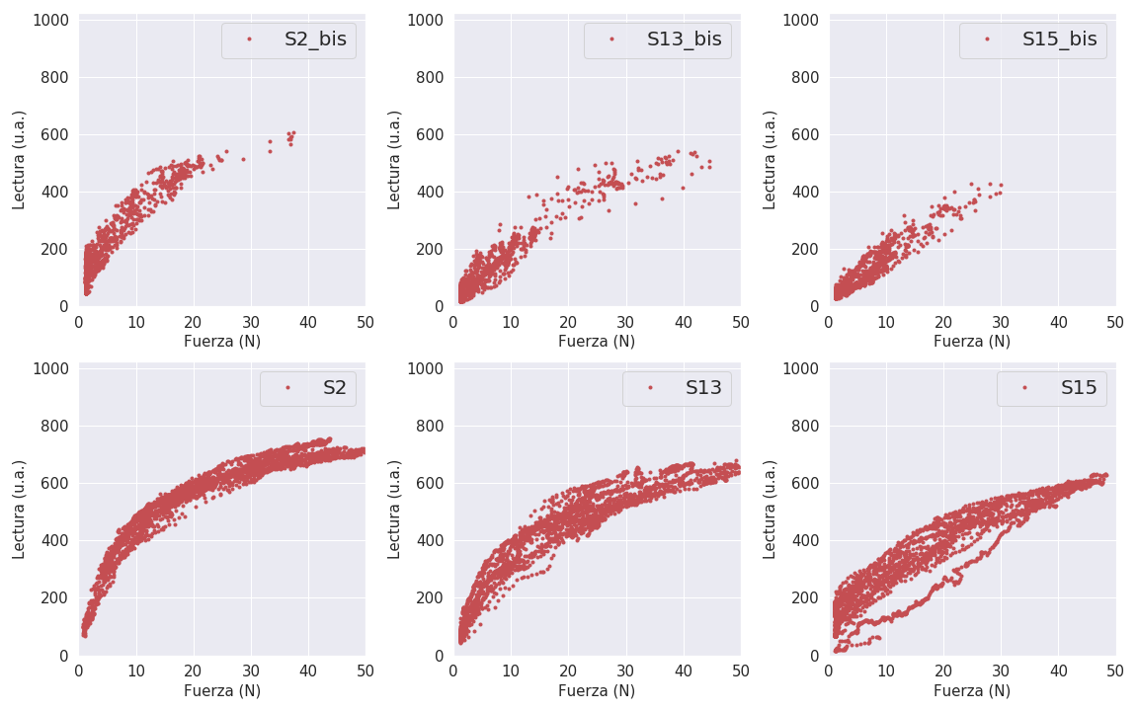

Slide 2
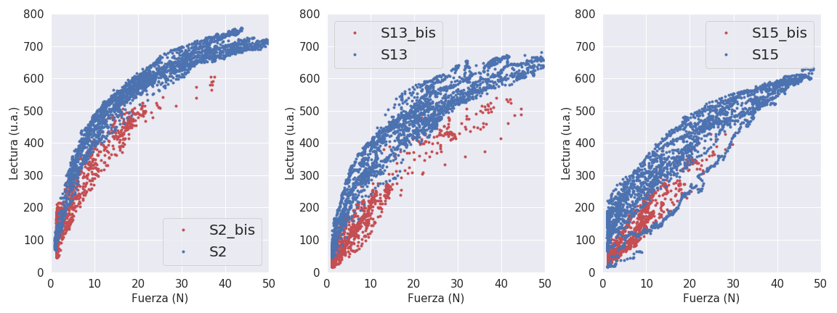
Superpuestas, hasta 800 ua

Slide 3
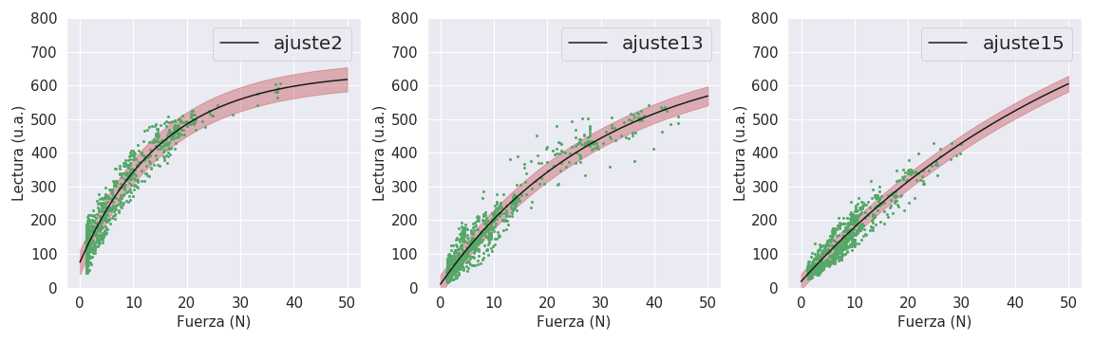
Exponencial
Parámetros = [[75.07233363303094, -36.498091576890594, 0.06460933903551455], [10.115984223545363, -22.61770449262454, 0.03254169811547916], [17.718610590559724, -17.57701611164902, 0.017406911989024776]]
Covarianza = [array([[ 3.25490820e+00, 1.31834608e+00, -3.72199797e-03],
[ 1.31834608e+00, 7.97554539e-01, -2.52385341e-03],
[-3.72199797e-03, -2.52385341e-03, 8.88251166e-06]]), array([[ 1.63716500e+00, 3.80809645e-01, -1.05755386e-03],
[ 3.80809645e-01, 1.46717952e-01, -4.71547340e-04],
[-1.05755386e-03, -4.71547340e-04, 1.75492393e-06]]), array([[ 1.45502321e+00, 3.57652174e-01, -1.70562419e-03],
[ 3.57652174e-01, 1.32441764e-01, -7.39390569e-04],
[-1.70562419e-03, -7.39390569e-04, 4.79242371e-06]])]

Slide 4
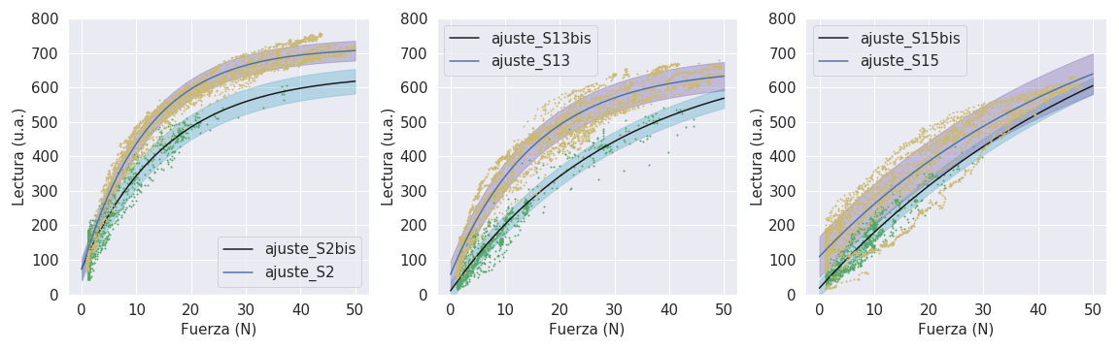
Exponencial juntos
Parámetros = [[71.526429544518, -53.960598063725215, 0.08369359578630431], [57.7045765773706, -38.58295147116597, 0.06446821283648956], [109.13633886203239, -16.729701086785692, 0.019912534371787294]]
Covarianza = [array([[ 6.92847571e+00, 1.40088990e+00, -1.50157296e-03],
[ 1.40088990e+00, 3.43067834e-01, -4.25227392e-04],
[-1.50157296e-03, -4.25227392e-04, 5.88430761e-07]]), array([[ 7.15380865e+00, 1.32630591e+00, -1.90941295e-03],
[ 1.32630591e+00, 3.26168445e-01, -5.57930442e-04],
[-1.90941295e-03, -5.57930442e-04, 1.06905999e-06]]), array([[ 6.08804339e+00, 7.60038984e-01, -1.94069603e-03],
[ 7.60038984e-01, 1.53525941e-01, -4.70545347e-04],
[-1.94069603e-03, -4.70545347e-04, 1.58926613e-06]])]

Slide 5
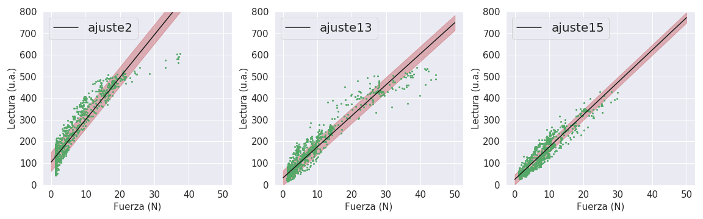
Lineal
Parámetros = [[19.591189054982575, 105.14157430745652], [14.336108396398679, 31.612512888456628], [14.953379904917874, 24.181404538512464]]
Covarianza = [array([[ 0.03789361, -0.17073103],
[-0.17073103, 2.08907568]]), array([[ 0.01240152, -0.07588543],
[-0.07588543, 1.26260575]]), array([[ 0.01397763, -0.0784999 ],
[-0.0784999 , 0.81962286]])]

Slide 6
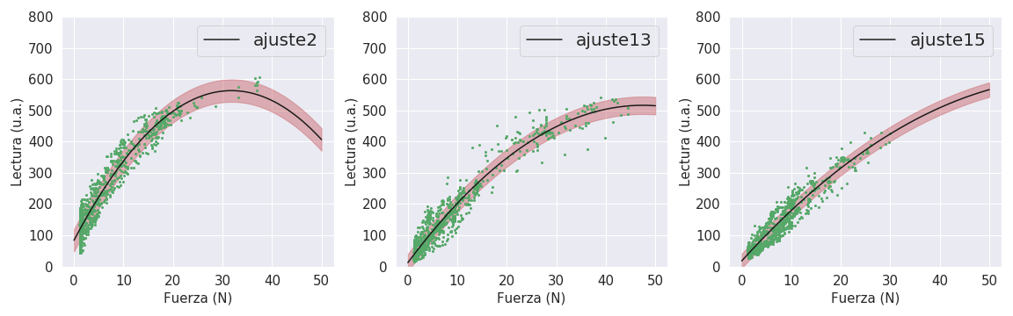
Cuadrática
Parámetros = [[-0.473620721382911, 30.13372103784265, 83.75253636664664], [-0.22346546272882914, 21.222223969682943, 12.227222581293974], [-0.12920132235219922, 17.426226054207145, 17.869760901624723]]
Covarianza = [array([[ 2.83682080e-04, -6.31460416e-03, 1.28112783e-02],
[-6.31460416e-03, 1.65377882e-01, -3.96991775e-01],
[ 1.28112783e-02, -3.96991775e-01, 1.94680148e+00]]), array([[ 6.43862160e-05, -1.98406908e-03, 5.58540656e-03],
[-1.98406908e-03, 6.93157997e-02, -2.22147152e-01],
[ 5.58540656e-03, -2.22147152e-01, 1.31697661e+00]]), array([[ 2.25307681e-04, -4.31227176e-03, 1.10065567e-02],
[-4.31227176e-03, 9.58624180e-02, -2.85510046e-01],
[ 1.10065567e-02, -2.85510046e-01, 1.31920069e+00]])]

Slide 7
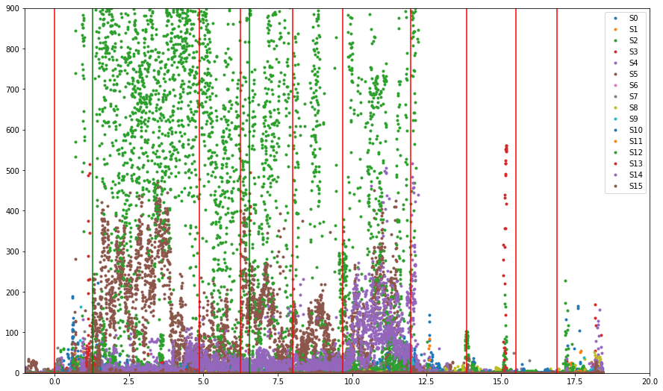
Datos crudos medición Fer
Me gustaria chequear que ande bien el sensor que esta marcando una lectura tan alta…
Se corresponde con la zona que fer dice que sintio mas presion, pero es un monton :o
Sube al subte
Tiempo (min)

Slide 8
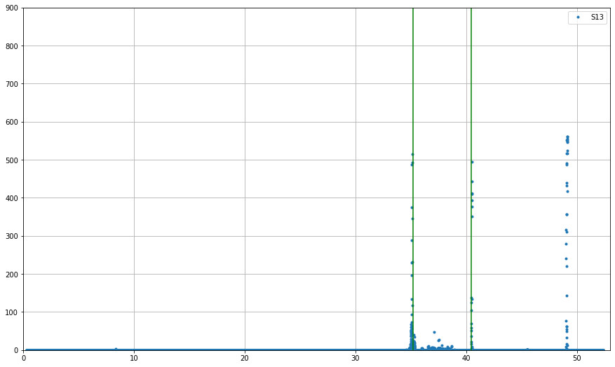
Toque sensor pecho
Sólo lo tocó 2 veces (pareciera que hay un tercer toque pero sin marca temporal en cronometro).
Para ser una medicion de 50 minutos coinciden super bien los tiempos, por eso no le hice correccion de tiempos…
solo movi el “cero” a cuando se subió al subte

Slide 9
